Slide 1
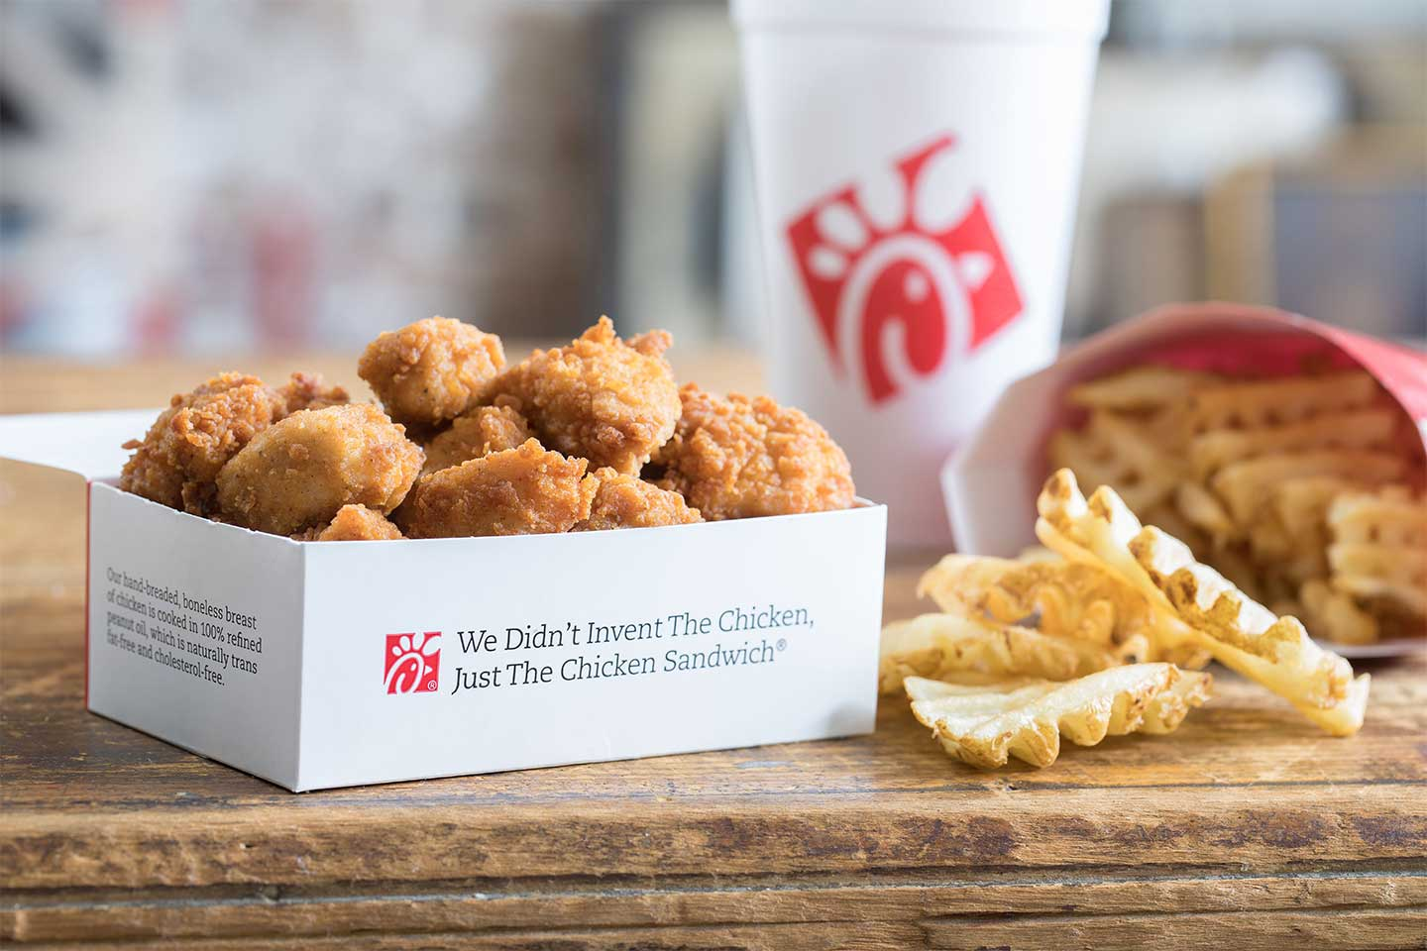
If it’s real chicken it's gotta be Chick-fil-a
EAT MORE CHICKEN!

