Slide 1
GHS-DECA
Co-Advisors:
Mrs. Jones Ms. Serra

Slide 2
What is DECA?

Slide 3
Mission Statement:
DECA prepares emerging leaders and entrepreneurs in marketing, finance, hospitality and management in high schools and colleges around the globe.

Slide 4
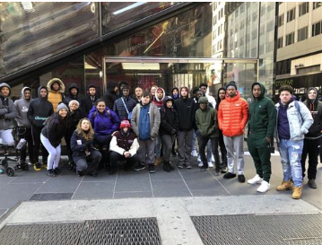
What do members of DECA do?
In order to prepare students to be leaders in the fields of Marketing, Entrepreneurship, Finance, Hospitality and Management, we take field trips to several businesses & corporations.
Planned trips include: Nike Headquarters in New York, Amazon Warehouse, Five Below Headquarters in Philadelphia, QVC Headquarters in West Chester, PA (Once Covid-19 restrictions are lifted)

Slide 5
What do members of DECA do?
Deca students participate in Business & Marketing Day Six Flags Competition.
Six Flags give DECA students a new challenge each year. Past challenges included marketing a new ride, writing a marketing plan for promotional events or for hiring new employess.
GHS has won the competition 10 out of the past 12 years.
Trip to Six Flags: In order to find out how we placed in the competition, we go to the park for a presentation and winners get to enjoy remained of the day at the park for free!!!

Slide 6
What do members of DECA do?
Deca members take part in the County Consumer Bowl Competition with the potentional to advance to the Regional/State level.
The competition is set up like a TV game show, similar to Jeopardy. It is fast paced, exiting and fun.
Students answer questions about all types of topics regarding being a wise consumer.

Slide 7
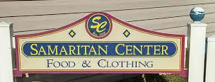
What do members of DECA do?
Community Service Projects:
Chick-fil-A Spirit night-% of sales goes to Samaritan House in Glassboro
Collection of personal hygiene products, socks, gloves, hats, scarves for those in need in our community in the cold, winter months.

Slide 8
What do members of DECA do?
New Project this year: Update and Rehab the school store.
DECA students will design and remodel the layout of the school store.
Students will determine the products for sale, pricing, placement and the promotion of the products.
Eventually, we would like to propose to administration that students take part in working in the school store during scheduled hours to gain service hours.

Slide 9
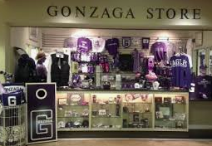
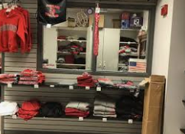
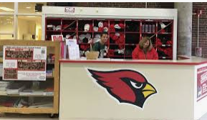
School Store Ideas??

Slide 10
DECA holds elections for club officers:
President
Vice-President
Secretary
Treasurer
Community Service Liason

Slide 11
When will we meet?
1st and 3rd Monday of each month at 3:00pm
For now, we will meet virtually via Zoom in Ms. Serra’s personal room.
Link: Zoom Meeting Link will be on Schoology Group Page
Our First meeting will be 10/13/20 @3:00PM
Remind Code: f3d9hc

Slide 12
Last Name | First Name | Grade | Contact Number(for Remind)

