Slide 1
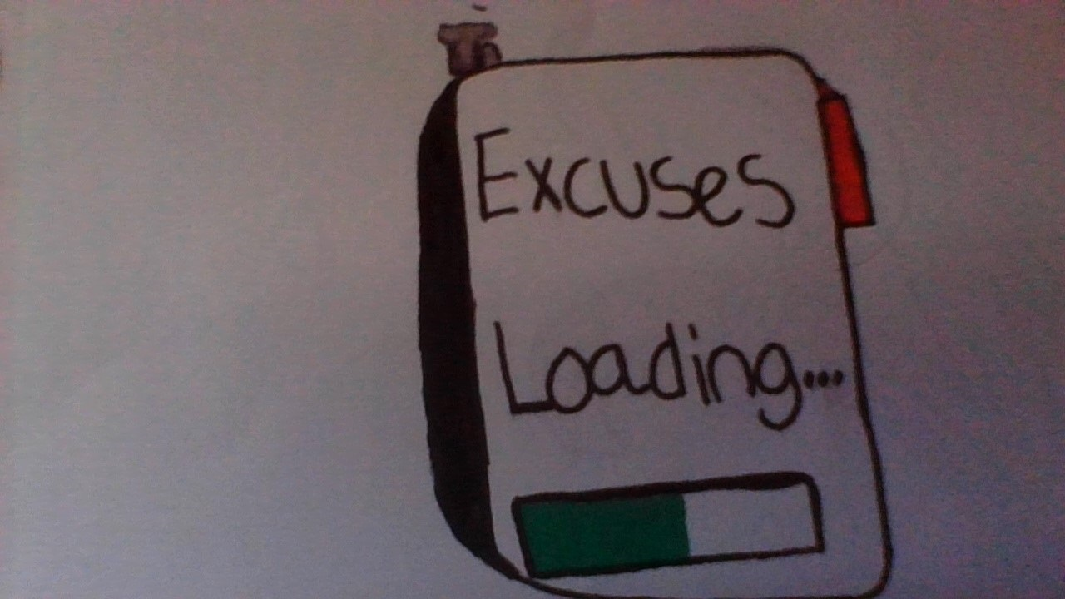
The Excuseinator
Done By: Joey Mingioni and Moriah Neube
The Excuseinator, This machine can come up with over 300 realistic excuses that you can use anytime anywhere. For example Say you forget to turn in your homework you can have a reason why in seconds. It comes with a wireless charger in the box and has 7 hours of use.
The Price: 65.00$
This is a picture of what the machine looks like.
It will be sold online only

