Slide 1
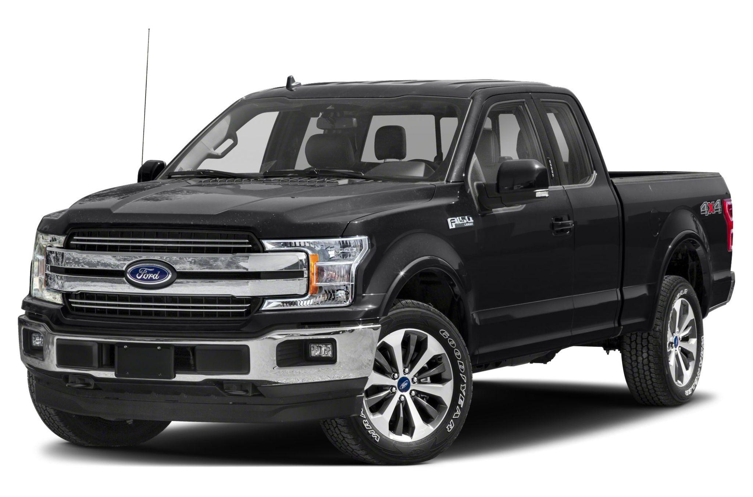
Logo for ford truck
Ford for all you're working needs

